Slide 1
ICFM Webinar 8 MANAGED RETREIT
Slobodan P. Simonović
Chairperson of the ICFM Ad Hoc Committee
Western University
Institute for Catastrophic Loss Reduction
London, Ontario, Canada

Slide 2
ICFM update
ICFM9 – Tsukuba, Japan February 19-21, 2023
LOC under the leadership of Prof. Toshio KOIKE
Conference web page – www.icfm9.jp
Call for abstracts completed
Around 300 abstracts received
Review under way – end of May deadline
Looking forward to seeing you all in Tsukuba

Slide 3
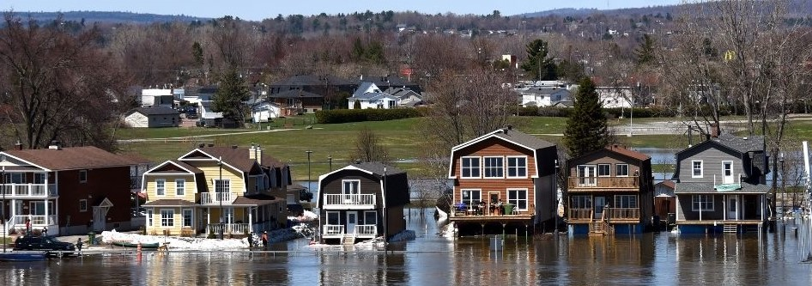
Webinar No.8
Flooding remains the leading natural disaster around the world
Climate change continues to affect flooding (sea level rise, stronger storms…)
Between November 2021 (Webinar No.7) and today - South Africa, Australia, Thailand, Brazil, Peru, Middle east, Philippines….
Use of structural solutions still dominates the flood management
The non-structural measures are gaining more attention
The conservation about moving people is just beginning
Managed retreat increasingly seen as necessity in response to climate change

Slide 4
Webinar No.8
Managed retreat not new concept
Gilbert White – relocation among key “adjustments” for reducing the risk of flooding
General definition - “the purposeful, coordinated, movement of people and assets out of harm’s way”
Complex challenges - legal, logistical, ethical, political, financial, and architectural
From MANAGING UNAVOIDABLE TO AVOIDING UNMANAGEABLE

Slide 5
Webinar No.8
Dr. Nirupama Agrawal (Canada)
Never too late – A case for retreat from floodplains
Dr. Jos van Alphen (The Netherlands)
Dutch ‘Room for the river’ programme
Dr. Sharad Jain (India)
Managed retreat as an adaptation tool – Opportunities and concerns tool
Dr. Zhang Xiaolei (China)
New trends in floodplains management – Digital twin basin

Slide 6
Webinar No.8
Thank you
Presenters
Participants
Organization by the ICFM Permanent Secretariat at IWHR
Leadership of Dr. Zhang CHENG (Chairperson)

